Slide 1

TECHNOVA SOLUTIONS: COMPREHENSIVE OVERVIEW, STRATEGIC WORK PLAN AND DETAILED STATISTICS REPORT.
Hafsa
Batch-41
07-12-2024

Slide 2


Overview
TechNova Solutions is a cutting-edge technology company dedicated to providing innovative solutions to modern-day challenges. Our mission is to harness the power of technology to create products and services that enhance the quality of life for individuals and businesses alike.
TechNova Solutions is poised for growth and ready to take on the challenges of the future. With a strong foundation, a clear vision, and a commitment to excellence, we are confident in our ability to lead the way in technological innovation

Slide 3
Objectives
Innovation
Integrity
Collaboration
Customer Focus

Slide 4

Products/Services
TechNova Solutions
Software Development
Cloud Services
AI and Machine Learning
Cybersecurity
Hardware Selling

Slide 5

Analysis
 | Yearly Report 2024
Month | Expenses | Sales | Profit
January | 9288500 | 8750000 | -538500
February | 9744300 | 9920000 | 175700
March | 8904700 | 10000000 | 1095300
April | 7345200 | 7957400 | 612200
May | 8987000 | 9876500 | 889500
June | 5215400 | 5164500 | -50900
July | 9976500 | 11543600 | 1567100
August | 7976700 | 8087900 | 111200
September | 9879000 | 9969800 | 90800
October | 6234800 | 7024000 | 789200
November | 4534800 | 4809300 | 274500
December | 8348700 | 8834800 | 486100

Slide 6
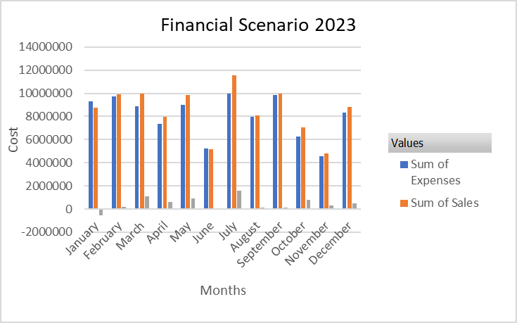
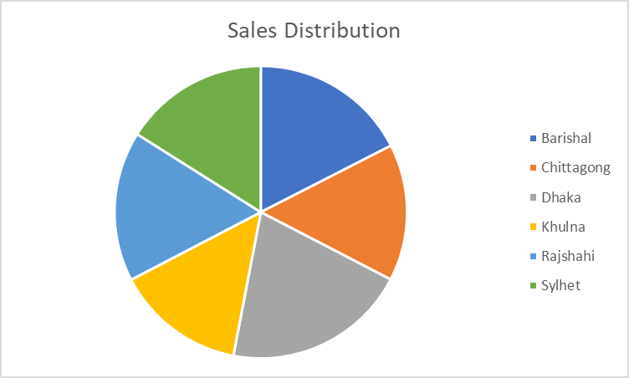

Slide 7
Conclusion
In conclusion, TechNova Solutions is not just a tech company; it is a beacon of progress and a catalyst for change. With its visionary approach and unwavering commitment to excellence, TechNova Solutions is set to achieve remarkable milestones and leave a lasting impact on the world.

Slide 8
Thank You

